Slide 1
Traditional Deep Learning
Justin Cata 4/12/23

Slide 2

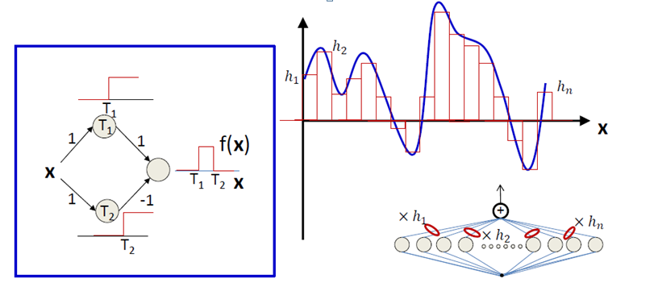
Universal Approximation Theorem?

Slide 3
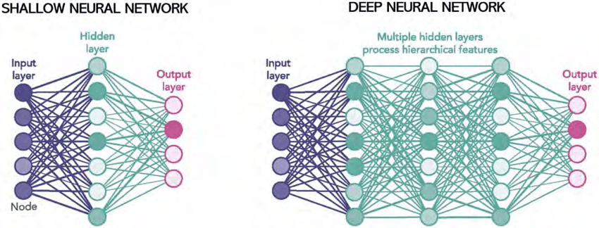
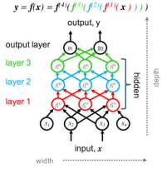
Why Deep as opposed to Shallow?

Slide 4
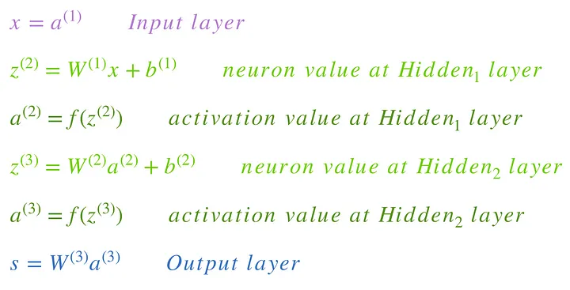
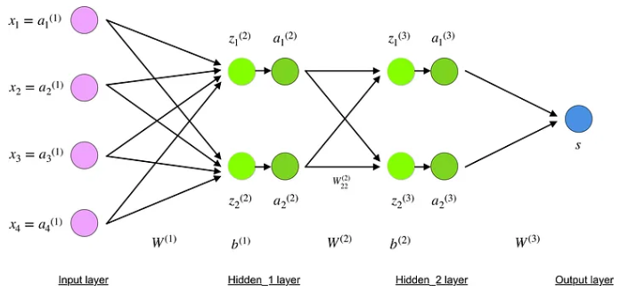
Formalism (forward propagation)

Slide 5
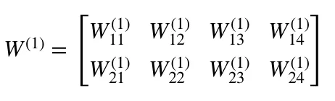
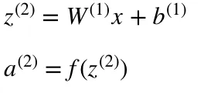
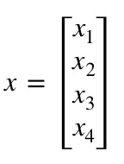
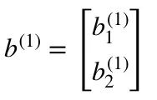
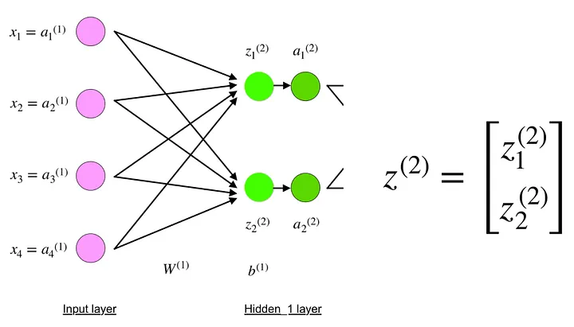
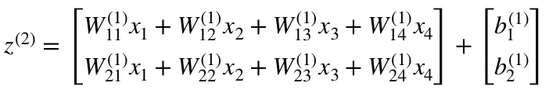
Formalism (hidden layer)

Slide 6
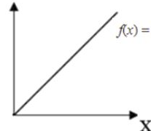
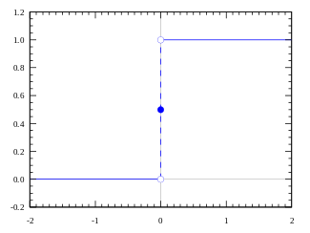
Activation Functions (heuristics)
Linear Function
Step Function
Intermediate values [0,1]
Consider derivative during G.D.
Constant Backprop changes; gradient has no relationship to Z.
N linear layers <-> 1 linear layer !
Determines activation {0,1}
But consider multiple active neurons
No intermediate values, so no good when multiple neurons involved.

Slide 7
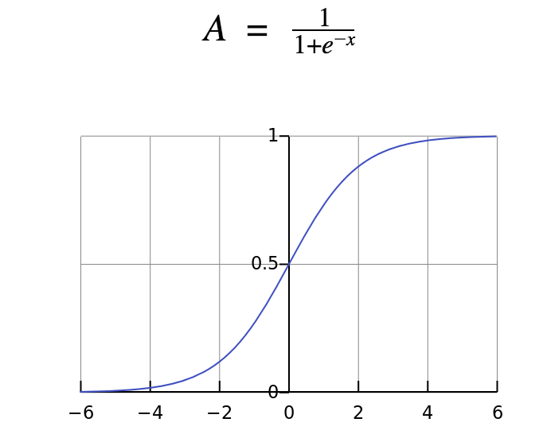
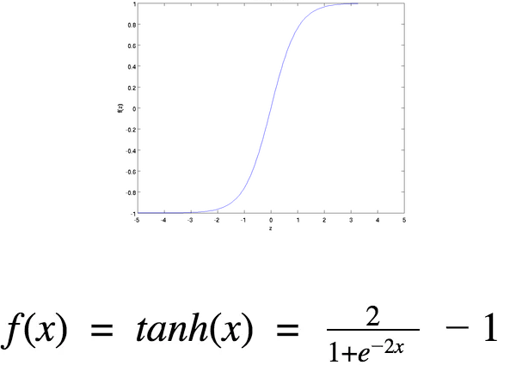

Activation Functions (heuristics)
Sigmoid
Tanh
Combinations Non-Linear
But tail ends
Gradient is small or has vanished; network refuses to learn further
Combinations Non-Linear
gradient is stronger for tanh than sigmoid ( derivatives are steeper).
Deciding between the sigmoid or tanh will depend on your requirement of gradient strength

Slide 8
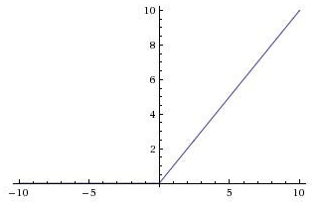
Activation Functions (heuristics)
ReLu
A(x) = max(0,x)
Combinations Non-Linear
Promotes Sparsity
But gradient can go to 0
Neurons in this state will stop firing; Dying ReLu Problem
Can try to slightly incline the horizontal part (Leaky ReLu)

Slide 9
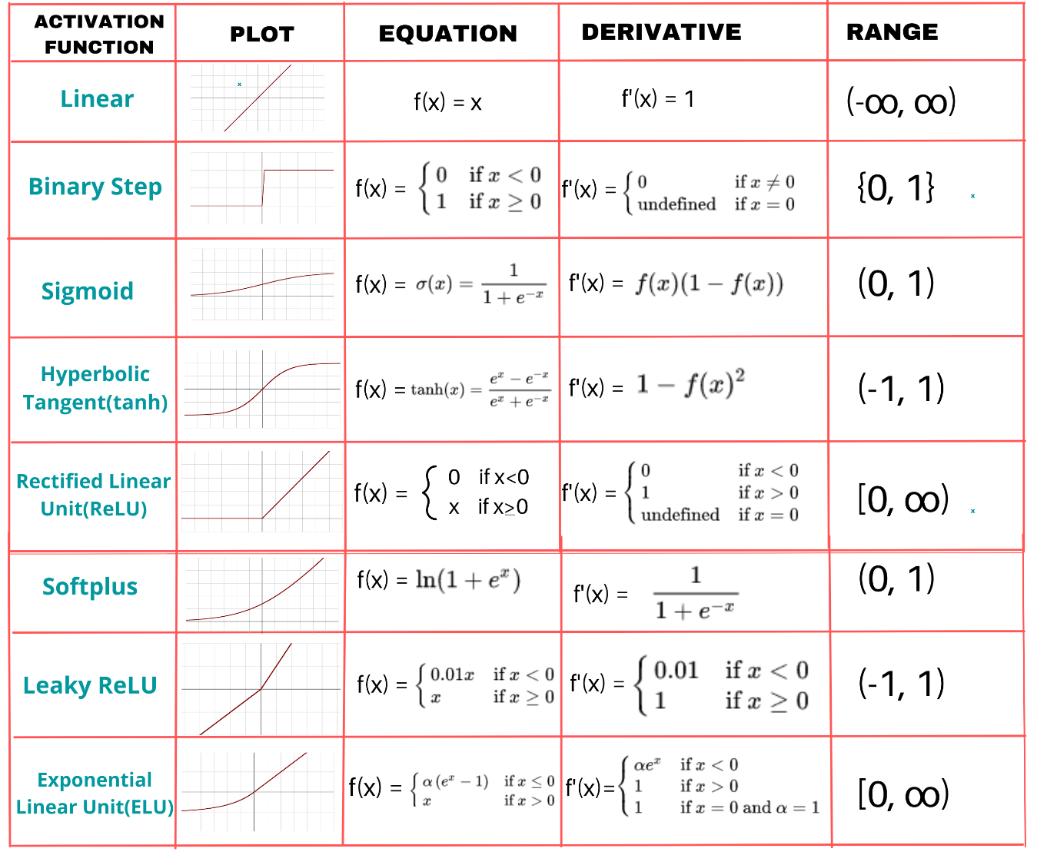
Activation Function Summary

Slide 10

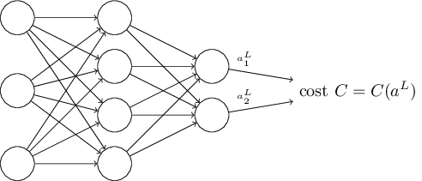
Cost Functions ( properties )
1)
The cost function 𝐶 must be able to be written as an average over cost functions for individual training examples:
This is so it allows us to compute the gradient (with respect to weights and biases) for a single training example, and run G.D.
2)
The second assumption we make about the cost is that it can be written as a function of the outputs from the neural network:
We make this restriction so we can backpropagate

Slide 11

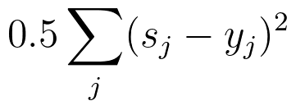
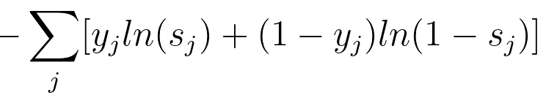
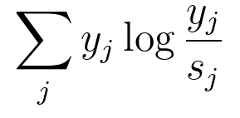
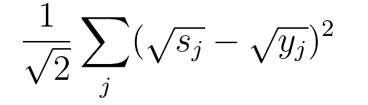
Cost Functions
 | Quadratic (MSE) | Cross-Entropy | Kullback-Leibler (KL) Divergence | Hellinger
Formula
Use Case | Regression | Classification | Distribution Estimation | Distribution Estimation

Slide 12
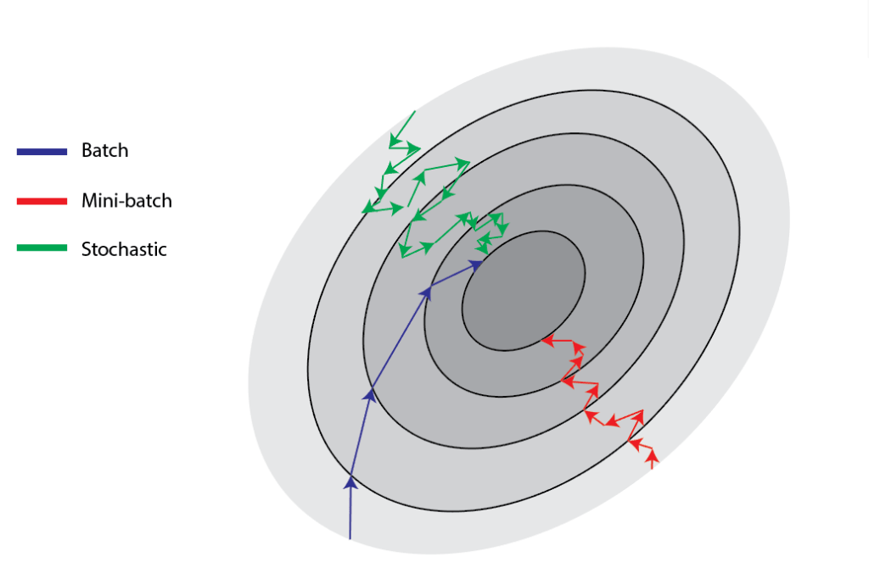
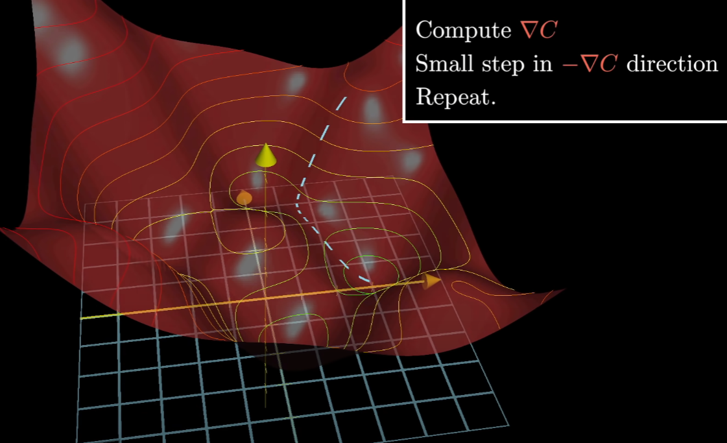
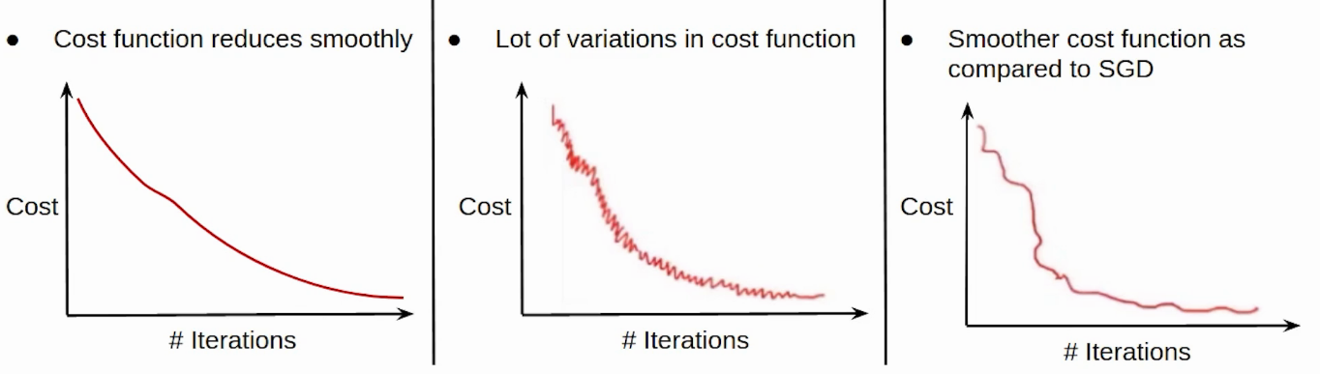
What does it mean to learn? ( Backpropagation )
backpropagation aims to minimize the cost function by adjusting network’s weights and biases

Slide 13
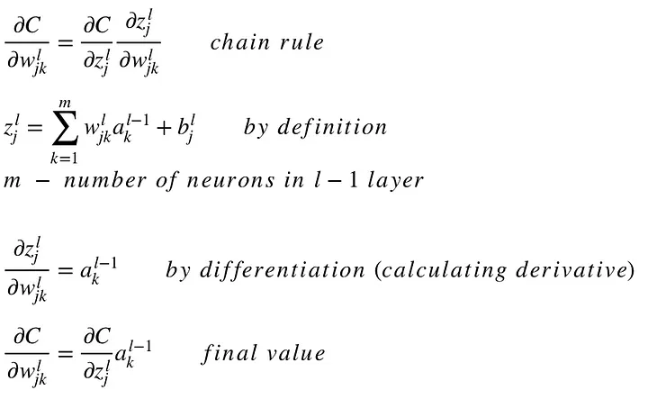
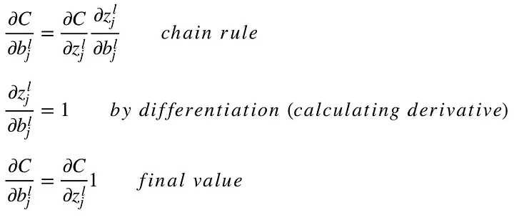
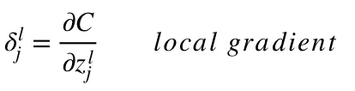
Formalism ( backpropagation )

Slide 14
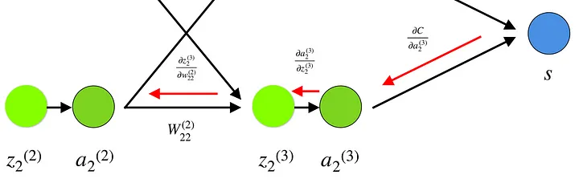
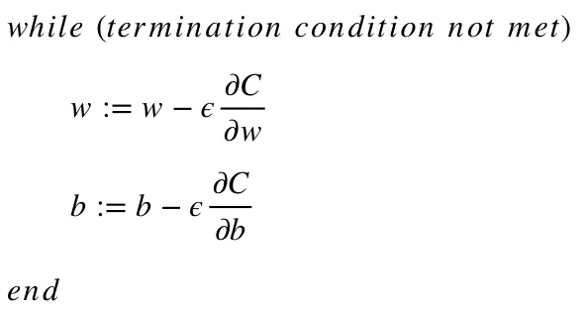

Formalism ( backpropagation )

Slide 15
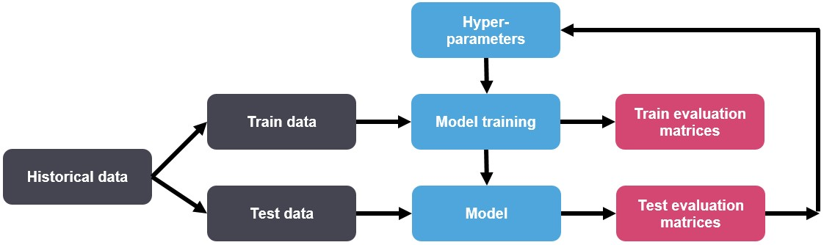
Hyperparameters
A parameter whose value is used to control the learning process.

Slide 16

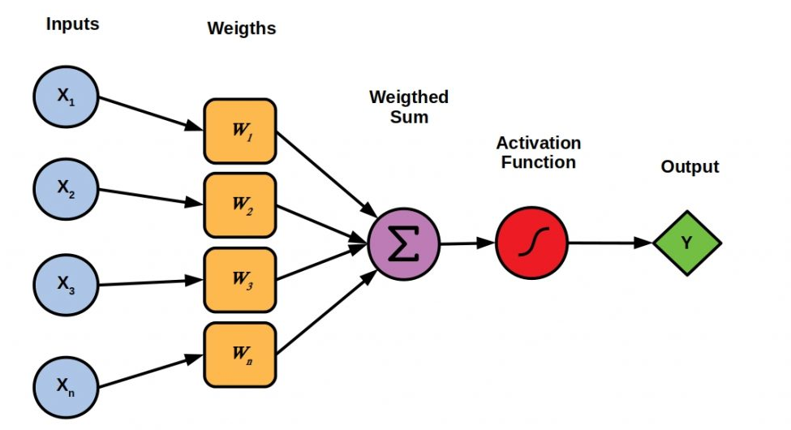
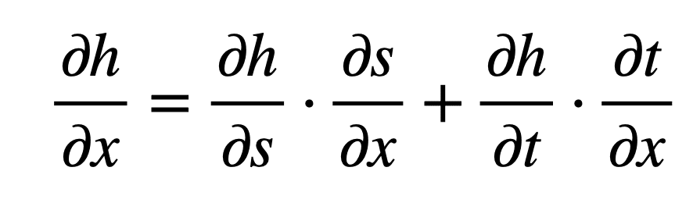

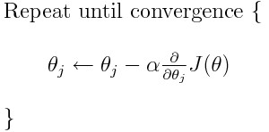
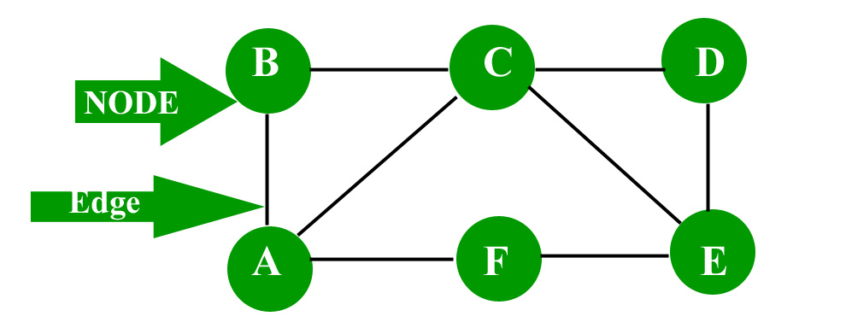

Ontology
Theory | Ontology | Mathematical Representation of Ontology | Purely Mathematical Facts | Nomology
Deep Learning / Neural Networks | Training Data Perceptron Hidden Layers |  | Universal Approximation Theorem | Forward propagation Backpropagation

Slide 17

Applications to Quantitative Finance
Calibration and Pricing Engines
Provided:
Parametric stochastic model:
Set of liquid instruments with payoff P:
Observed market prices Obs
Goal:
Determine stochastic parameters s.t. prices match observed market:
Provided parameters, determine price

Slide 18



Applications to Quantitative Finance
Advantages:
• Flexible in terms of varying risk parameters and assumptions
• Extends to a large class of instruments/payoffs (vanilla, exotics)
• Largely adopted, consolidated
Calibration and Pricing Engines
QF method: Monte Carlo Simulation
Determine stochastic parameters via Monte Carlo:
Provided parameters, determine price
Disadvantages:
• Heavy computationally
• For calibration engines the computational burden grows even more due to multiple runs required
• Complex stochastic models become outside the scope of production

Slide 19

Applications to Quantitative Finance
Calibration and Pricing Engines
Advantages:
• Inference time order of magnitudes faster than MC while preserving accuracy
• Provides a genuine (non-linear) differentiable function which can leverage automatic differentiation framework for both inference (sensitivities) and training (Differential ML)
• Can produce high-dimensional output (e.g. full implied volatility surface) further reducing inference time
DL method: Supervised learning neural network
• Utilize the MC engine as an oracle to generate training data for a neural network and train to minimize MSE loss:
• Provided observed market data and learned neural calibration engine, determine stochastic parameters by solving (either numerically or with gradient-based techniques) for the minima:
Disadvantages:
• Still relies on MC to generate training data and the amount of data required for training might need to grow exponentially with the dimensionality of the input
• Training time is still not negligible although reasonable
• Architectural choices might affect accuracy for more complex/high-dimensional models

Slide 20




Applications to Quantitative Finance
Differential Equation Solvers
Derivative Pricing:
Stochastic Optimal Control ( portfolio allocation / optimal liquidation ):
Markovian state process X:
Control process 𝛼 and cost func J:
Lead to HJB equation for value function of problem u for some Hamiltonian H:

Slide 21
Applications to Quantitative Finance
Differential Equation Solvers
Advantages:
• Largely adopted, consolidated
• Adaptable to a large number of types of equations
• Error analysis can be done analytically (e.g. using Taylor expansion)
QF method: Finite differences
Approximation numerical technique based on discretization of the partial (integral) differential equations.
Fixed a grid in the equation variables and a discretization schema for differentials (implicit, explicit method), reduce the equation to a linear system solved starting from the known initial/boundary conditions.
Disadvantages:
• Curse of dimensionality: computational complexity generally grows exponentially with the number of variables of the equation.
• Relies on linear estimates of both the coefficients and the solution of the equation on the grid of reference
• Grid choices affect stability of the solver

Slide 22

Applications to Quantitative Finance
Advantages:
• Unsupervised, does not require generation of training data
• Provides a genuine (non-linear) differentiable function which can leverage automatic differentiation framework for inference (e.g. sensitivities) and training. Inherently mesh-free.
Differential Equation Solvers
DL method: Deep Galerkin Method
• Learning the solution to the equation as a neural network f in the variables minimizing the residual equation and boundary conditions error J(f)
Disadvantages:
• Accuracy depends pretty substantially on hyper-parameters used during training and choices of architectures. Knowledge of the equation and boundary conditions helps guiding these choices.
• Training-time is still not negligible
• Solves for only one (possibly a system) equation at the time

Slide 23
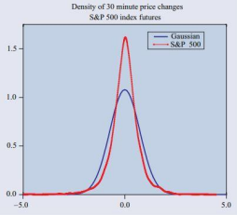
Applications to Quantitative Finance
Modeling Financial Time Series
Key feature for any simulation engine is the ability to replicate empirical statistics of observed time-series.
These features are known in the literature as stylized facts. For assets returns, most salient observed statistics are:
• autocorrelations (linear) are often insignificant
• (unconditional) distribution displays a power-law or Pareto-like tail (heavy tails)
• volatility display a positive autocorrelation over several days (volatility clustering)
• ACF of absolute returns decays slowly as a function of the time lag
• measures of volatility are negatively correlated with returns (leverage effect)

Slide 24

Applications to Quantitative Finance
Modeling Financial Time Series
Advantages:
• Consolidated practice with a sound statistical theory
QF method: Calibration of stochastic processes
Standard practice involves assuming a stochastic model for the time-series and calibrating its parameters to observed data (Euler-Murayama). Common stochastic processes are GBM, Heston stochastic volatility model:
Vasicek model, HullWhite model, GARCH models:
Disadvantages:
• Relies on a statistical prior assumption about the distribution
• More complex stochastic models can lead to computational over-heads
• Non-linear relations may be weakly captured
• Statistical theory weakens outside of ‘Gaussian world’, especially with respect to heavy-tailed distributions

Slide 25
Applications to Quantitative Finance
Modeling Financial Time Series
Advantages:
• Model free, does not require strong assumptions on the modeling
• Can recover some stylized facts
• Architectural biases have representational power for temporal structure and to express non-linearity
DL method: Deep generative modeling of time series
GANs (Generative Adversarial Networks) are characterized by two neural networks called the generator and the discriminator. Given distributions X and Z (X is an observed distribution and Z is a latent stochastic code)
• Generator G produces, for each z in Z, an element G(z) close in distribution to x in X
• Discriminator D attempts to discriminate between samples generated by G and natural samples of X More specifically, GAN optimization is achieved through solving a min-max problem of the form:
Specific applications to financial modeling include:
• WGAN, DCGAN, RegGAN
• Autoregressive GAN for option prices
• TCN (WaveNet)
Disadvantages:
• Require medium to large datasets for training, computationally intense to train
• GANs are notoriously hard to train (collapse mode) hence could require intense hyper-parameters search

Slide 26
References
https://towardsdatascience.com/understanding-backpropagation-algorithm-7bb3aa2f95fd
https://medium.com/the-theory-of-everything/understanding-activation-functions-in-neural-networks-9491262884e0
https://stats.stackexchange.com/questions/154879/a-list-of-cost-functions-used-in-neural-networks-alongside-applications
B. Horvath, A. Muguruza and M. Tomas, Deep learning volatility: a deep neural network perspective on pricing and calibration in (rough) volatility models, Quantitative Finance, 21:1, 2021.
J. Sirignano and K. Spiliopoulos, DGM: A deep learning algorithm for solving partial differential equations. Journal of Computational Physics 375(3), 2017
R. Cont, Empirical properties of asset returns: stylized facts and statistical issues, Quantitative Finance Vol. 1 (2001), pp. 223-236.
G. Di Cerbo, A. Hirsa and A. Shayaan, Regularized Generative Adversarial Network, Available at SSRN 3796240.
M. Wiese, R. Knobloch, R. Korn and P. Kretschmer, Quant GANs: deep generation of financial time series, Quantitative Finance Volume 20, 2020 - Issue 9.
T. Huster et al., Pareto GAN: Extending the Representational Power of GANs to Heavy-Tailed Distributions, ICML 2021.

